Slide 1
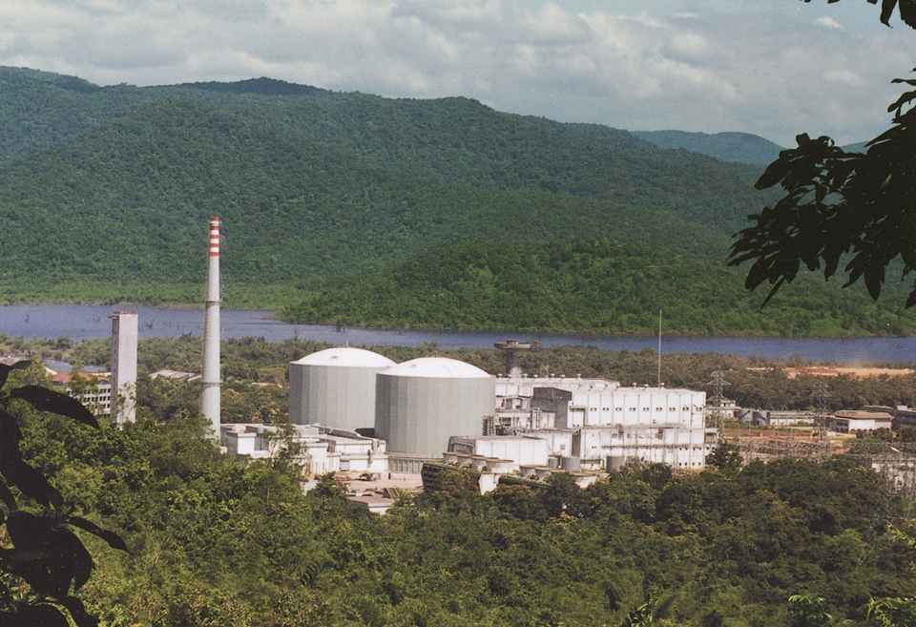


11th Nuclear Energy Conclave
18th Oct 2019

Slide 2

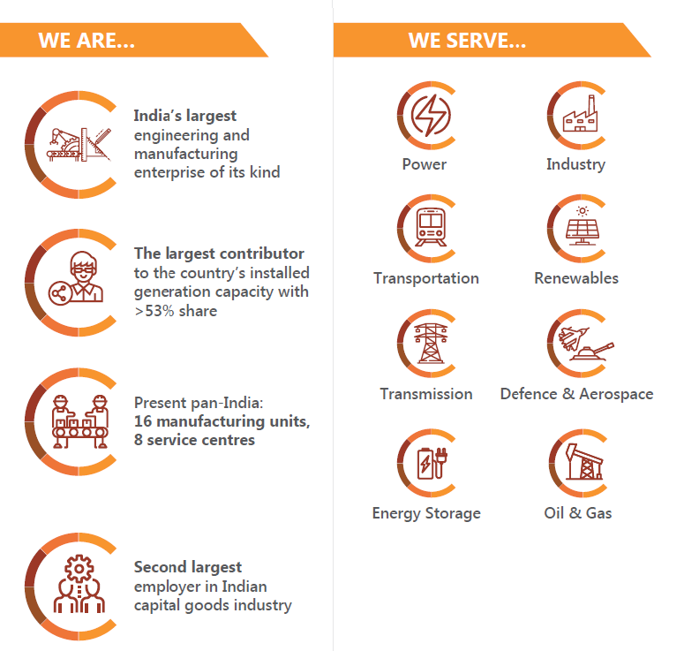
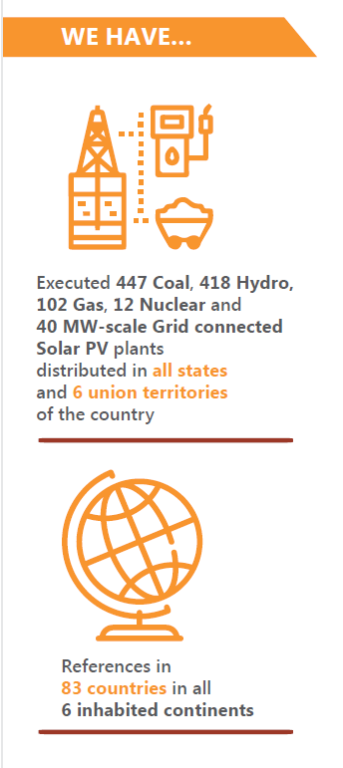
Who we are …and ….what we do…

Slide 3

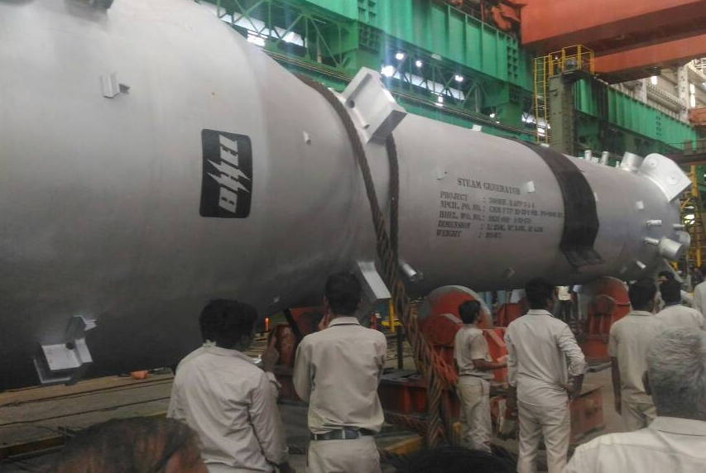
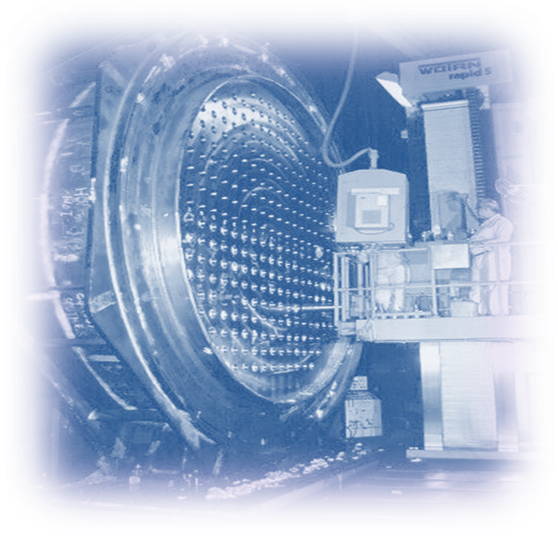
Decades of experience /association in Nuclear…
- A reliable partner in all the 3 stages of India’s Nuclear Power Programme
Be it Primary or Secondary- We do it all with the huge manufacturing prowess
Primary side
Secondary side
  An established supplier for
  Steam Generators
  (36 nos. already in
  service)
  Reactor Headers
  End shields
  CCIP
  12 out of 18 operating PHWRs in the Country are equipped with BHEL supplied Steam Turbine Generator sets accounting for
  74% of the Nuclear Power capacity
  (3.28 GWe out of 4.46 Gwe)
BHEL is the only Indian TG Supplier for PHWRs.
    10 x 220 MW
    (RAPP 3&4, MAPP 1&2,
    NAPP 1&2, KAPP 1& 2 and
    Kaiga 1& 2)
    2 x 540 MW (Tarapur 3&4 )
NPCIL’s PHWR unit 1 at KAIGA has created a world record for continuous operation of 962 days.

Slide 4
Fully geared up to address the upcoming Business opportunities..….
Have proven Turbine island solution for the forthcoming 700 MW PHWRs
Our EPC model is based on
    Integration competencies
    Deep understanding of both Thermal & Nuclear power systems and local requirements
    Maximum in-house manufacturing strength (Steam Turbine, Generator, Moisture Separator Re-heater, Condenser, LP Heater, Other major equipment of TG island including piping, Complete Controls & Instrumentation…)
    Capability for simultaneous construction activities at multiple sites
    Integrated Project Management approach
- Accordingly a most suitable Techno-Commercial proposal for 6x700 MWe ‘TG island’ on ‘EPC’ basis is under evaluation with NPCIL
Have multiple centres for addressing the needs of Primary Side Equipment.

Slide 5
KEY ISSUES… for Speedy Implementation
1
Striking a balance between the rights and obligations of both Purchaser and Supplier…
2
Bringing milestone focus in execution…
3
Increased localization in case of LWR Projects envisaged through foreign cooperation…

Slide 6

Thanks !
P P Yadav
Executive Director, BHEL
Nuclear Business Group,

